Slide 1
Ch 15
Security
NEU – 2016

Slide 2
Security & Vulnerabilities
Main threats – Attackers & Code
Attackers
Masquerader
Outsider
Misfeasor
Insider
Clandestine
Either
Passive & Active Attacks

Slide 3
Passive Attacks
Attempts to learn or make use of information from the system but does not affect system resources
Are in the nature of eavesdropping on, or monitoring of, transmissions
Goal of the attacker is to obtain information that is being transmitted
Difficult to detect because they do not involve any alteration of the data
is feasible to prevent the success of these attacks by means of encryption
Emphasis in dealing with passive attacks is on prevention rather than detection
INFORMATION is not just DATA
Types:
release of message contents
traffic analysis
Notes:
Network security attacks can be classified
as passive attacks and active attacks . A passive attack attempts to learn or make
use of information from the system but does not affect system resources. An active
attack attempts to alter system resources or affect their operation.
Passive attacks are in the nature of eavesdropping on, or monitoring of, transmissions.
The goal of the attacker is to obtain information that is being transmitted.
Two types of passive attacks are release of message contents and traffic analysis.
The concept of release of message contents , is easily understood. A telephone
conversation, an electronic mail message, and a transferred file may contain sensitive
or confidential information. We would like to prevent an opponent from learning the
contents of these transmissions.
Traffic analysis is a more subtle form of passive attack. Suppose that we had a
way of masking the contents of messages or other information traffic so that opponents,
even if they captured the message, could not extract the information from
the message. The common technique for masking contents is encryption. If we had
encryption protection in place, an opponent might still be able to observe the pattern
of these messages. The opponent could determine the location and identity of
communicating hosts and could observe the frequency and length of messages being
exchanged. This information might be useful in guessing the nature of the communication
that was taking place.
Passive attacks are very difficult to detect because they do not involve any
alteration of the data. Typically, the message traffic is sent and received in an apparently
normal fashion, and neither the sender nor the receiver is aware that a third
party has read the messages or observed the traffic pattern. However, it is feasible
to prevent the success of these attacks, usually by means of encryption. Thus, the
emphasis in dealing with passive attacks is on prevention rather than detection.

Slide 4

Active Attacks
Involve some modification of the data stream or the creation of a false stream
Examples:
Replay
involves the passive capture of a data unit and its subsequent retransmission to produce an unauthorized effect
Masquerade
takes place when one entity pretends to be a different entity
Modification of messages
some portion of a legitimate message is altered, or that messages are delayed or reordered, to produce an unauthorized effect
Denial of service
prevents or inhibits the normal use or management of communications facilities
disruption of an entire network either by disabling the network or by overloading it with messages so as to degrade performance
Notes:
Active attacks involve some modification of the data stream or the creation
of a false stream and can be subdivided into four categories: replay, masquerade,
modification of messages, and denial of service.
Replay involves the passive capture of a data unit and its subsequent retransmission
to produce an unauthorized effect.
A masquerade takes place when one entity pretends to be a different entity. A
masquerade attack usually includes one of the other forms of active attack. For example,
authentication sequences can be captured and replayed after a valid authentication
sequence has taken place, thus enabling an authorized entity with few privileges
to obtain extra privileges by impersonating an entity that has those privileges.
Modification of messages simply means that some portion of a legitimate
message is altered, or that messages are delayed or reordered, to produce an
unauthorized effect. For example, a message stating, “Allow John Smith to read confidential
file accounts ” is modified to say, “Allow Fred Brown to read confidential
file accounts .”
The denial of service prevents or inhibits the normal use or management of
communications facilities. This attack may have a specific target; for example, an
entity may suppress all messages directed to a particular destination (e.g., the security
audit service). Another form of service denial is the disruption of an entire network,
either by disabling the network or by overloading it with messages so as to degrade
performance.
Active attacks present the opposite characteristics of passive attacks. Whereas
passive attacks are difficult to detect, measures are available to prevent their success.
On the other hand, it is quite difficult to prevent active attacks absolutely,
because to do so would require physical protection of all communications facilities
and paths at all times. Instead, the goal is to detect them and to recover from any
disruption or delays caused by them. Because the detection has a deterrent effect, it
may also contribute to prevention.

Slide 5
How can we prevent attacks?
Authentication
Password, PIN, token, biometric, …
Intrusion Detection/Prevention Systems
Patterns of behavior
Access Control
Firewalls (port, protocol, time, …)
MAC address filtering
File system controls

Slide 6
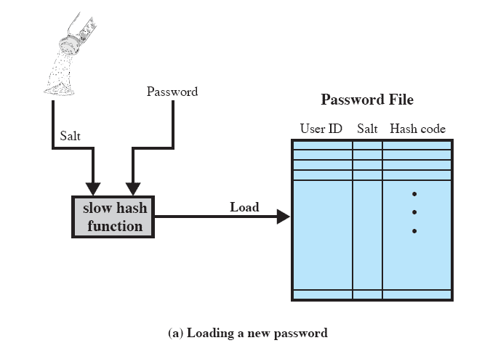
Hashed Passwords/Salt Value
Notes:
A widely used password security technique is
the use of hashed passwords and a salt value. This scheme is found on virtually all
UNIX variants as well as on a number of other operating systems. The following
procedure is employed ( Figure 15.1a ). To load a new password into the system,
the user selects or is assigned a password. This password is combined with a fixed length
salt value [MORR79]. In older implementations, this value is related to the
time at which the password is assigned to the user. Newer implementations use a
pseudorandom or random number. The password and salt serve as inputs to a hashing
algorithm to produce a fixed-length hash code. The hash algorithm is designed to
be slow to execute to thwart attacks. The hashed password is then stored, together
with a plaintext copy of the salt, in the password file for the corresponding user
ID. The hashed-password method has been shown to be secure against a variety of
cryptanalytic attacks [WAGN00].

Slide 7
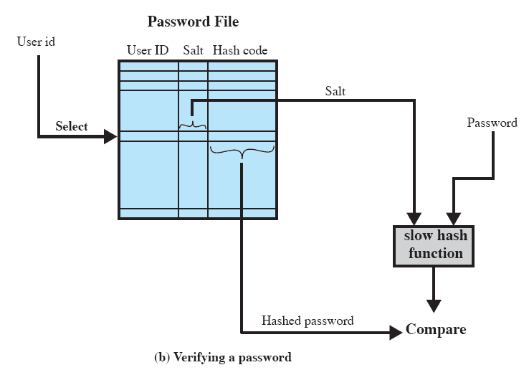
UNIX Password Scheme
Notes:
When a user attempts to log on to a UNIX system, the user provides an ID
and a password ( Figure 15.1b ). The operating system uses the ID to index into the
password file and retrieve the plaintext salt and the encrypted password. The salt
and user-supplied password are used as input to the encryption routine. If the result
matches the stored value, the password is accepted.

Slide 8

Salt
Serves three purposes:
prevents duplicate passwords from being visible in the password file
even if two users choose the same password, the passwords will be assigned different salt values
greatly increases the difficulty of offline dictionary attacks
it becomes nearly impossible to find out whether a person with passwords on two or more systems has used the same password on all of them
Notes:
The salt serves three purposes:
• It prevents duplicate passwords from being visible in the password file. Even
if two users choose the same password, those passwords will be assigned
different salt values. Hence, the hashed passwords of the two users will
differ.
• It greatly increases the difficulty of offline dictionary attacks. For a salt of
length b bits, the number of possible passwords is increased by a factor of 2 b ,
increasing the difficulty of guessing a password in a dictionary attack.
• It becomes nearly impossible to find out whether a person with passwords on
two or more systems has used the same password on all of them.
To see the second point, consider the way that an offline dictionary attack
would work. The attacker obtains a copy of the password file. Suppose first that the
salt is not used. The attacker’s goal is to guess a single password. To that end, the
attacker submits a large number of likely passwords to the hashing function. If any
of the guesses matches one of the hashes in the file, then the attacker has found a
password that is in the file. But faced with the UNIX scheme, the attacker must take
each guess and submit it to the hash function once for each salt value in the dictionary
file, multiplying the number of guesses that must be checked.

Slide 9
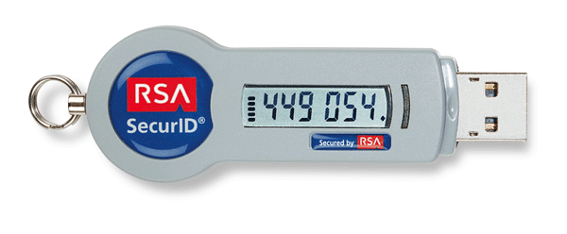
Token
Symmetric key-based
Generates a new one-time password (OTP) every 60 seconds
Synchronizes each authenticator with the security server
The one-time password is coupled with a secret personal identification number (PIN)
Creates a combination nearly impossible to guess
Notes:
Each RSA SecurID authenticator has a unique symmetric key that is combined with a proven algorithm to generate a new one-time password (OTP) every 60 seconds. Patented technology synchronizes each authenticator with the security server, ensuring a high level of security. The one-time password—something the user has—is coupled with a secret personal identification number (PIN)—something the user knows—to create a combination that is nearly impossible for a hacker to guess. This protection is priceless when the risk of exposing critical information resources is considered.
http://www.tokenguard.com/RSA-SecurID-SID800.asp

Slide 10
Intrusion Detection System
RFC 4949 (Internet Security Glossary) defines intrusion detection as a security service that monitors and analyzes system events for the purpose of finding, and providing real-time or near real-time warning of, attempts to access system resources in an unauthorized manner
Intrusion detection systems (IDSs) can be classified as:
host-based IDS
monitors the characteristics of a single host and the events occurring within that host for suspicious activity
network-based IDS
monitors network traffic for particular network segments or devices and analyzes network, transport, and application protocols to identify suspicious activity
Notes:
RFC 4949 (Internet Security Glossary ) defines intrusion
detection as follows: A security service that monitors and analyzes system events
for the purpose of finding, and providing real-time or near real-time warning of,
attempts to access system resources in an unauthorized manner.
Intrusion detection systems (IDSs) can be classified as follows:
• Host-based IDS: Monitors the characteristics of a single host and the events
occurring within that host for suspicious activity
• Network-based IDS: Monitors network traffic for particular network segments
or devices and analyzes network, transport, and application protocols to
identify suspicious activity

Slide 11
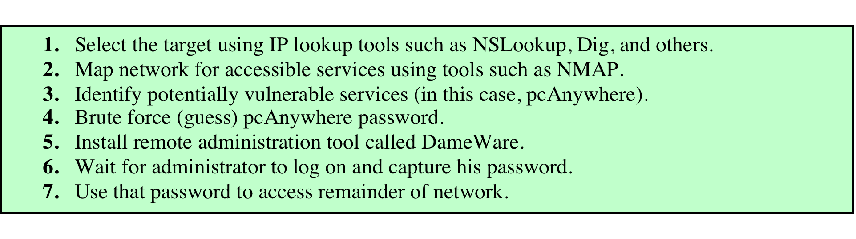
Table 14.3 Intruder Patterns of Behavior: Hackers
Traditionally those who hack do so for the thrill of it or for status
Attackers often look for targets of opportunity and then share the information with others
Benign intruders consume resources and may slow performance for legitimate users
Intrusion detection systems (IDSs) and intrusion prevention systems (IPSs) are designed to counter this type of hacker threat
Computer emergency response teams (CERTs) are cooperative ventures who collect information about system vulnerabilities and disseminate it to systems managers
Notes:
The techniques and behavior patterns of intruders are constantly shifting, to exploit
newly discovered weaknesses and to evade detection and countermeasures. Even
so, intruders typically follow one of a number of recognizable behavior patterns,
and these patterns typically differ from those of ordinary users. In the following,
we look at three broad examples of intruder behavior patterns to give the reader
some feel for the challenge facing the security administrator. Table 14.3 , based on
[RADC04], summarizes the behavior.
HACKERS
Traditionally, those who hack into computers do so for the thrill of
it or for status. The hacking community is a strong meritocracy in which status
is determined by level of competence. Thus, attackers often look for targets of
opportunity and then share the information with others. A typical example is a
break-in at a large financial institution reported in [RADC04]. The intruder took
advantage of the fact that the corporate network was running unprotected services,
some of which were not even needed. In this case, the key to the break-in was the
pcAnywhere application. The manufacturer, Symantec, advertises this program as
a remote control solution that enables secure connection to remote devices. But the
attacker had an easy time gaining access to pcAnywhere; the administrator used the
same three-letter username and password for the program. In this case, there was
no intrusion detection system on the 700-node corporate network. The intruder was
only discovered when a vice president walked into her office and saw the cursor
moving files around on her Windows workstation.
Benign intruders might be tolerable, although they do consume resources and
may slow performance for legitimate users. However, there is no way in advance to
know whether an intruder will be benign or malign. Consequently, even for systems
with no particularly sensitive resources, there is a motivation to control this problem.
Intrusion detection systems (IDSs) and intrusion prevention systems (IPSs),
of the type described in this Chapter 15 , are designed to counter this type of hacker
threat. In addition to using such systems, organizations can consider restricting
remote logons to specific IP addresses and/or use virtual private network technology.
One of the results of the growing awareness of the intruder problem has been
the establishment of a number of computer emergency response teams (CERTs).
These cooperative ventures collect information about system vulnerabilities and
disseminate it to systems managers. Hackers also routinely read CERT reports.
Thus, it is important for system administrators to quickly insert all software patches
to discovered vulnerabilities. Unfortunately, given the complexity of many IT
systems and the rate at which patches are released, this is increasingly difficult to
achieve without automated updating. Even then, there are problems caused by
incompatibilities resulting from the updated software (hence the need for multiple
layers of defense in managing security threats to IT systems).

Slide 12
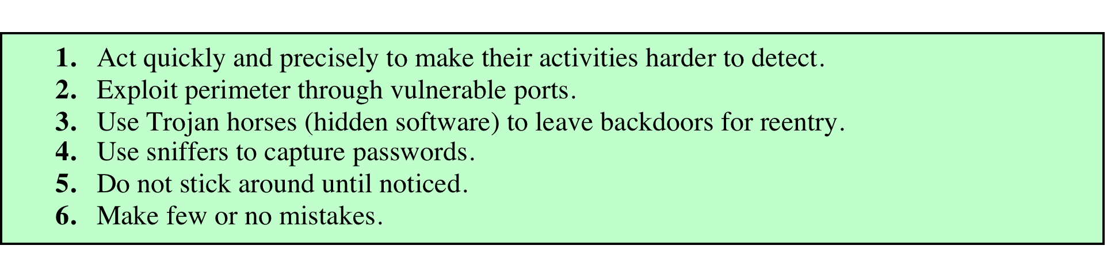
Table 14.3 Intruder Patterns of Behavior: Criminal Enterprise
Organized groups of hackers
They meet in underground forums to trade tips and data and coordinate attacks
A common target is a credit card file at an e-commerce server
Usually have specific targets, or at least classes of targets in mind
Quick in and quick out attacks
(b) Criminal Enterprise
Notes:
Organized groups of hackers have become a widespread and common
threat to Internet-based systems. These groups can be in the employ of a corporation
or government but often are loosely affiliated gangs of hackers. Typically, these
gangs are young, often Eastern European, Russian, or southeast Asian hackers who
do business on the Web [ANTE06]. They meet in underground forums with names
like DarkMarket.org and theftservices.com to trade tips and data and coordinate
attacks. A common target is a credit card file at an e-commerce server. Attackers
attempt to gain root access. The card numbers are used by organized crime gangs
to purchase expensive items and are then posted to carder sites, where others can
access and use the account numbers; this obscures usage patterns and complicates
investigation.
Whereas traditional hackers look for targets of opportunity, criminal hackers
usually have specific targets, or at least classes of targets in mind. Once a site is
penetrated, the attacker acts quickly, scooping up as much valuable information as
possible and exiting.
IDSs and IPSs can also be used for these types of attackers but may be less
effective because of the quick in-and-out nature of the attack. For e-commerce
sites, database encryption should be used for sensitive customer information,
especially credit cards. For hosted e-commerce sites (provided by an outsider
service), the e-commerce organization should make use of a dedicated server (not
used to support multiple customers) and closely monitor the provider’s security
services.

Slide 13
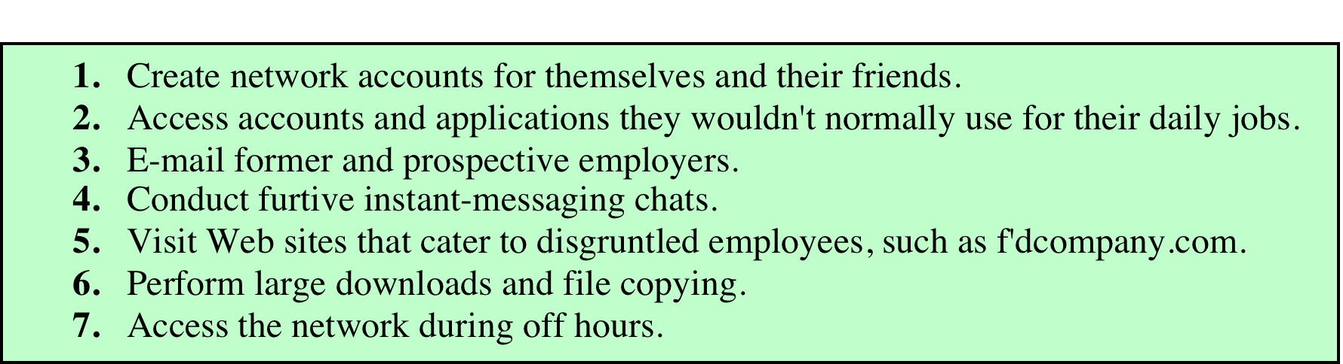
Table 14.3 Intruder Patterns of Behavior: Insider Attacks
Among the most difficult to detect and prevent
Can be motivated by revenge or simply a feeling of entitlement
Employees already have access to and knowledge of the structure and content of corporate databases
(c) Internal Threat
Notes:
Insider attacks are among the most difficult to detect and
prevent. Employees already have access to and knowledge of the structure and
content of corporate databases. Insider attacks can be motivated by revenge or
simply a feeling of entitlement. An example of the former is the case of Kenneth
Patterson, fired from his position as data communications manager for American
Eagle Outfitters. Patterson disabled the company’s ability to process credit card
purchases during 5 days of the holiday season of 2002. As for a sense of entitlement,
there have always been many employees who felt entitled to take extra office
supplies for home use, but this now extends to corporate data. An example is that of
a vice president of sales for a stock analysis firm who quit and went to a competitor.
Before she left, she copied the customer database to take with her. The offender
reported feeling no animus toward her former employee; she simply wanted the
data because it would be useful to her.
Although IDS and IPS facilities can be useful in countering insider attacks,
other more direct approaches are of higher priority. Examples include the following:
• Enforce least privilege, only allowing access to the resources employees need
to do their job.
• Set logs to see what users access and what commands they are entering.
• Protect sensitive resources with strong authentication.
• Upon termination, delete employee’s computer and network access.
• Upon termination, make a mirror image of employee’s hard drive before reissuing
it. That evidence might be needed if your company information turns up
at a competitor.

Slide 14
Generalizing an Attack – Kill Chain
Reconnaissance – Research, identification and selection of targets, often represented as crawling Internet websites such as social networks, organizational conferences and mailing lists for email addresses, social relationships, or information on specific technologies.
Weaponization – Coupling a remote access trojan with an exploit into a deliverable payload. Increasingly, application data files such as PDFs or Microsoft Office documents serve as the weaponized deliverable.
Delivery – Transmission of the weapon to the targeted environment via, for example, email attachments, websites, and USB removable media.
Notes:
https://nigesecurityguy.wordpress.com/2013/06/04/defensible-security-posture/

Slide 15
Exploitation – After payload delivery to victim host, exploitation triggers intruders’ code. Exploitation targets an application or operating system vulnerability or leverages an operating system feature that auto-executes code.
Installation – Installation of a remote access trojan or backdoor on the victim system allows the adversary to maintain persistence inside the environment.
Command and Control – Advanced Persistent Threat malware typically establishes remote command and control channels so that intruders have “hands on the keyboard” access inside the target environment.
Actions on Targets – Typically the prime objective is data exfiltration which involves collecting, encrypting and extracting information from the victim environment. Intruders may only seek access to victim box for use as a jump point to compromise additional systems and move laterally inside the network or attack other partner organizations.

Slide 16
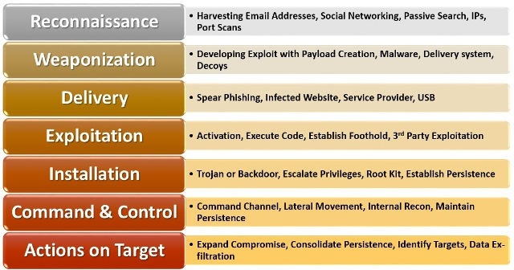
Kill Chain

Slide 17
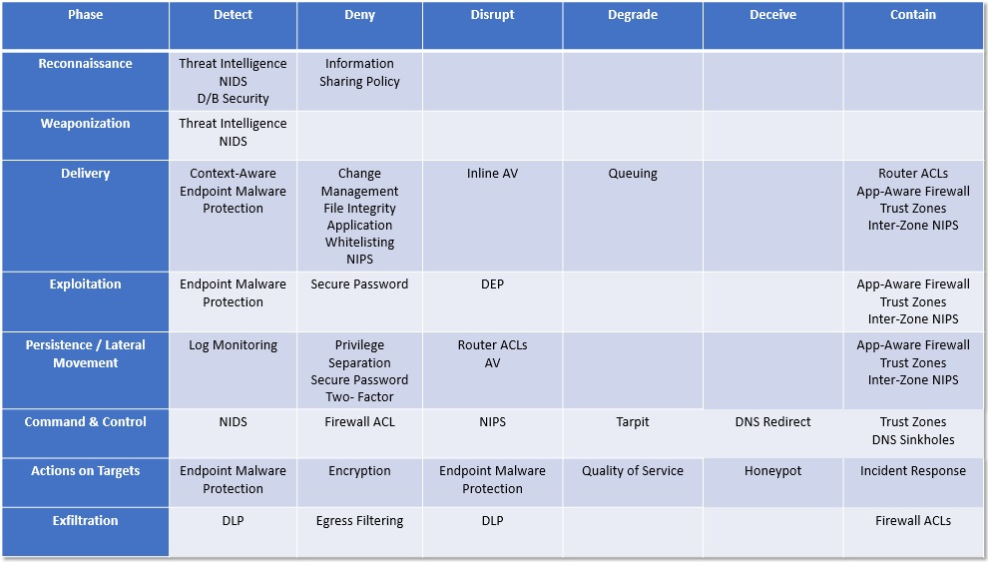
Defensible Security Posture
Notes:
https://nigesecurityguy.wordpress.com/tag/cyber-kill-chain/

Slide 18
Operating System Hardening
Keep patches up to date
Only run what’s necessary
Configure user and group permissions
Add-on security controls
Antivirus, host firewalls, IDS/IPS
Test security
http://www.whatsmyip.org/port-scanner/
https://www.grc.com

Slide 19
What are we trying to prevent?
Malware – malicious software
Viruses, worms, Trojans, insider attacks, backdoors, logic bombs, adware, spyware, …
Notes:
http://www.symantec.com/connect/articles/what-are-malware-viruses-spyware-and-cookies-and-what-differentiates-them

Slide 20
Viruses, Worms, Trojans, Rootkits
Malware can be classified into several categories, depending on propagation and concealment
Propagation
Virus: human-assisted propagation (e.g., open email attachment)
Worm: automatic propagation without human assistance
Concealment
Rootkit: modifies operating system to hide its existence
Trojan: provides desirable functionality but hides malicious operation
Various types of payloads, ranging from annoyance to crime
Notes:
Name derives from the wooden horse left by the Greeks at the gates of Troy during the siege of Troy
A Trojan horse program intentionally hides malicious activity while pretending to be something else
Usually described as innocuous looking, or software delivered through innocuous means which either allows to take control of systems
Trojan horse programs do not replicate themselves
Sometimes passed on using commonly passed executables, things like jokes forwarded by e-mail
Sometimes marketed/distributed as “remote administration tool”
Often combined with rootkits to disguise activity and remote access
Popularized to an extent by software like Cult of the Dead Cow’s Back Orifice, offered as a free download for running “remote administration” tasks or playing spooky jokes on friends
The line between user-launched worms and Trojans is highly blurred, with many user-launched worms behaving in a manner similar to worms.
Trojans are by definition malicious. The classic movie/television exploit of remotely opening disk drives is a definite symptom of being infected by a Trojan.
Have lately begun using much of the same defense mechanisms used by viruses, there are known Trojans which use WSH to run.
To detect infected computers, attackers often use so called sweep lists, list of IP addresses known to be online. One of the popular ways of doing this is to monitor IRC chat rooms and use the IP addresses of participants in these rooms.
Payload examples
perform amusing or annoying pranks
destroy/corrupt files and applications
monitor and transmit user activity (spyware, logger)
install backdoor (makes the infected computer a zombie)
email spam
launch denial-of-service attack
alter browser settings to display ads
dial out international or 900 numbers (dialer)

Slide 21
Insider Attacks
Someone who is a part of the organization
For malware, a security hole created by one of its programmers
E.g., a backdoor (sometimes trapdoor)
Hidden feature or command in a program that allows a user to perform actions he or she would not normally be allowed to do.
The program performs completely as expected and advertised under normal operations.
But if the hidden feature is activated, the program does something unexpected, often in violation of security policies, such as performing a privilege escalation.

Slide 22
Backdoors
Non-malicious
Malicious
Some backdoors are intentionally put into a program by its programmers
Debugging purpose (bypass some tedious steps to speed up debugging)
Many computer games have backdoors
Secret key code to change gaming role (full health, full map, invincible)
Deliberate backdoors inserted by malicious programmers
Blackmail, secret privilege
Backdoor created by malware on compromised machines
Open a TCP listening service, anyone can have a shell connection to the machine without account and password
Example: Code Red II
Notes:
https://en.wikipedia.org/wiki/Code_Red_II

Slide 23
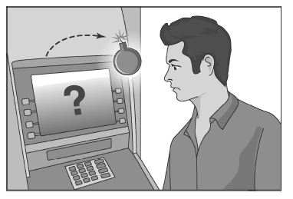
Logic Bombs
Performs a malicious action as a result of a certain logic condition
A programmer coding up the software for the payroll system puts in code that makes the program crash should it ever process two consecutive payrolls without paying him
Combine a logic bomb with a backdoor to tailor access

Slide 24
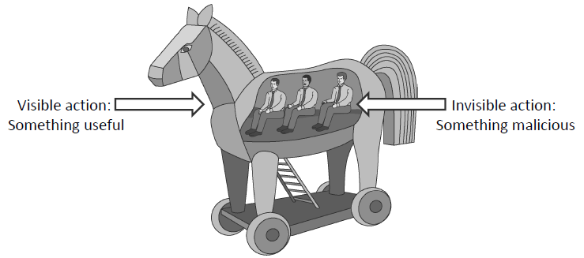
Trojan Horses
A Trojan horse (or Trojan) is a malware program that appears to perform some useful task, but which also does something with negative consequences (e.g., launches a keylogger).
Trojan horses can be installed as part of the payload of other malware but are often installed by a user or administrator, either deliberately or accidentally.

Slide 25
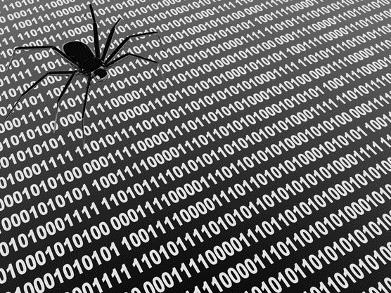


Adware
Adware software payload
Computer user
Adware engine infects
a user’s computer
Adware engine requests
advertisements
from adware agent
Advertisers contract with
adware agent for content
Adware agent delivers
ad content to user
Adware agent
Advertisers

Slide 26


Spyware
Spyware software payload
Computer user
1. Spyware engine infects
a user’s computer.
2. Spyware process collects
keystrokes, passwords,
and screen captures.
3. Spyware process
periodically sends
collected data to
spyware data collection
agent.
Spyware data collection agent

Slide 27
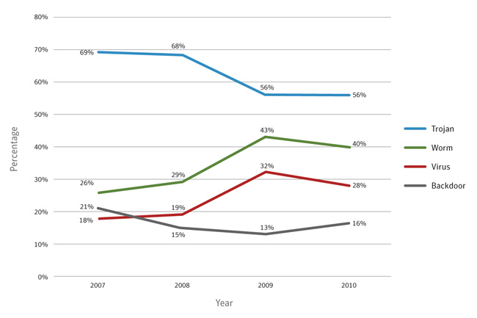
Recent Trends
Trojans currently have largest infection potential
Biggest financial motivation
Notes:
http://securityresponse.symantec.com/de/de/threatreport/topic.jsp?id=malicious_code_trends&aid=malicious_code_features

Slide 28
Impacts
True financial impacts are often not known
Impacted systems can be extensive
LoveBug (2000) caused $8.75B in damages and shut down the British parliament
In 2004, 8% of emails infected by W32/MyDoom.A at its peak
In February 2006, the Russian Stock Exchange was taken down by a virus
Heartbleed bug was introduced to OpenSSL in December 2011 and has been out in the wild since OpenSSL release 1.0.1 on 14th of March 2012. OpenSSL 1.0.1g released on 7th of April 2014 fixes the bug.
In 2015 the Stagefright exploit allows MMS messages to gain control of Android phones. It is believed that phones with Android 2.2 or higher are vulnerable to this attack, leaving more than 950 million phones susceptible.
Notes:
http://heartbleed.com/
http://www.digitaltrends.com/mobile/android-stagefright-mms-hack-news/

Slide 29
Defenses against Insider Attacks
Avoid single points of failure.
Use code walk-throughs.
Use archiving and reporting tools.
Limit authority and permissions.
Physically secure critical systems.
Monitor employee behavior.
Control software installations.

Slide 30
Signatures: A Malware Countermeasure
Scan and compare the analyzed object with a database of signatures
A signature is a virus fingerprint
E.g., a string with a sequence of instructions specific for each virus
Different from a digital signature
A file is infected if there is a signature inside its code
Fast pattern matching techniques to search for signatures
All the signatures together create the malware database that usually is proprietary

Slide 31
Heuristic Analysis
Useful to identify new and “zero day” malware
Code analysis
Based on the instructions, the antivirus can determine whether or not the program is malicious, i.e., program contains instruction to delete system files,
Execution emulation
Run code in isolated emulation environment
Such as in Virtual Machine
Monitor actions that target file takes
If the actions are harmful, mark as virus
Heuristic methods can trigger false alarms

Slide 32
White/Black Listing
Maintain database of cryptographic hashes for
Operating system files
Popular applications
Known infected files
Compute hash of each file in hard drives
Look up into database to compare
Needs to protect the integrity of the database
Example: TripWire software

Slide 33
Antivirus / Antimalware
Shield
Background process (service/daemon)
Scans each time a file is touched (open, copy, execute, etc.)
Demand
Scan on explicit user request or according to regular schedule
On a suspicious file, directory, drive, etc.
Quarantine
A suspicious file can be isolated
The suspicious file is not deleted but made harmless (e.g., by encrypting it)
Interacting with a file in quarantine it is possible only through the antivirus program

Slide 34
Online vs Offline Anti Virus Software
Online
Free browser plug-in
Authentication through third party certificate (i.e. VeriSign)
No shielding
Software and signatures update at each scan
Poorly configurable
Scan needs internet connection
Report collected by the company that offers the service
Offline
Paid annual subscription
Installed on the OS
Software distributed securely by the vendor online or a retailer
System shielding
Scheduled software and signatures updates
Easily configurable
Scan without internet connection
Report collected locally and may be sent to vendor

Slide 35
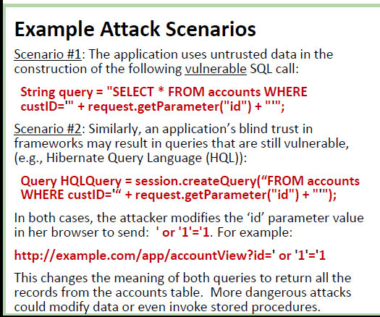
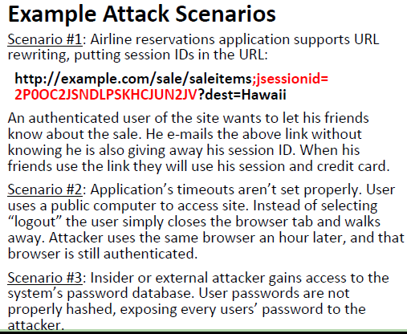
OWASP Top 10 web risks
Injection Attack
Broken Authentication & Session Management
Notes:
https://www.owasp.org/index.php/Main_Page
The Open Web Application Security Project (OWASP) is a 501(c)(3) worldwide not-for-profit charitable organization focused on improving the security of software. Our mission is to make software security visible, so that individuals and organizations worldwide can make informed decisions about true software security risks.

Slide 36
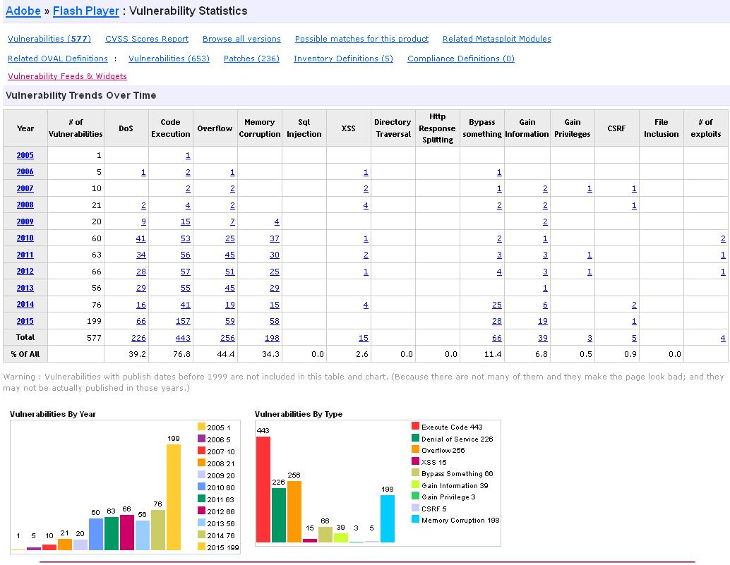
CVE Details (Common Vulnerabilities and Exposures)
Notes:
https://www.cvedetails.com/

Slide 37

Logic Bomb Example
Omega Engineering founded in 1962
Manufactures sensing components
1985 Tim Lloyd, machinist
1989-1990 Initiates computers, LAN manager
1994 Novell Network Certification

Slide 38
Tim Lloyd, Omega Engineering
1995 unraveling
Failure of quality tests results in massive customer returns
Written up, not a team player
Demoted in July 1995
April 1996 Bad performance memo
June 1996 Programs and files centralized from workstations to server

Slide 39
Tim Lloyd, Omega Engineering
July 1 1996, requests and receives server tape backup
July 10, Tim is fired
July 31, Novell NetWare file server is started…
A message appears stating that the server was being fixed
The server never came back online

Slide 40
Omega Engineering, Recovery
Restore from backup tape
Run CNC machines from workstations’ code
Panic
Data Recovery
Aug 12, 1996 Secret Service becomes involved
First federal criminal computer sabotage case

Slide 41
Kill Chain

Slide 42
Kill Chain Components…
A date of 7/30/1996
A supervisor account “12345” (no password)
Aug 21st Secret Service confiscation
Erased backup tapes
Hard Drives
Code later found on a personal drive…
Deltree.exe modified as fix.exe
(Fixing not Deleting!)

Slide 43
The Omega Bomb Code
The Logic Behind the Omega Engineering Time Bomb included the following strings:
7/30/96
Event that triggered the bomb
F:
Focused attention to volume F, which had critical files
F:\LOGIN\LOGIN 12345
Login a fictitious user, 12345 (the back door)
CD \PUBLIC
Moves to the public folder of programs
FIX.EXE /Y F:\*.*
Run a program, called FIX, which actually deletes everything
PURGE F:\/ALL
Prevent recovery of the deleted files

Slide 44
Kill Chain
Reconnaissance
Weaponization
Delivery
Exploitation
Installation
Command & Control
Actions on Target
Institutional (Insider) Knowledge
Alter deltree & wrap with logic bomb
Install & run as a scheduled job (insider)
Separated account (back door to execute)
Eliminate all data and possibilities of recovery

Slide 45
Computer Security Assignment
Omega Engineering
Insider threat
Systems unknowingly compromised
Piece together from very little data
Millions of dollars of damage
ClearThread
Outsider threat
System knowingly compromised
Piece together from collected evidence & snapshot of the infected machine
Notes:
http://www.craigchamberlain.com/library/insider/Case%20Study%20of%20Insider%20Sabotage.pdf

Slide 46
“ClearThread” has been breached
Download the (2.3GB) collected evidence and machine snapshot
rc01ucs213.managed.mst.edu (and 02, 03) /tmp/Upload.zip
WinSCP
USB / DVD ?
https://www.dropbox.com/s/dm0q7fmro6ogsx6/Upload.zip?dl=0
All characters appearing in this work are fictitious. Any resemblance to actual companies, or real persons, living or dead, is purely coincidental.

